Slide 1
State Agency Re-entry PPE Update
Presented by:
the South Carolina department of administration
JUNE 10, 2020

Slide 2
State Agency PPE Mission Plan
Four agencies collaborated to procure and distribute PPE for all state agencies:
  South Carolina Department of Administration
  South Carolina Emergency Management Division
  State Fiscal Accountability Authority
  South Carolina Department of Transportation
Notes:
Four agencies collaborated to procure and distribute Personal Protective Equipment (PPE) for all state agencies:
South Carolina Department of Administration
South Carolina Emergency Management Division
The State Fiscal Accountability Authority
The South Carolina Department of Transportation
These agencies have been working very closely together to ensure agencies have PPE and cleaning supplies to help limit the spread of COVID-19 as state employees return to the workplace during the phased re-entry process.

Slide 3
State Agency PPE Mission Plan
Collaboration helped the state leverage collective buying, which achieved:
  Greater purchasing power.
  More competitive pricing.
  Even distribution of high-demand and difficult to find items.
Notes:
This collaboration helped the state leverage collective buying, which achieved:
Greater purchasing power.
More competitive pricing.
Even distribution of high-demand and difficult to find items.
Collective buying allows for greater purchasing power, more competitive pricing and help with the even distribution of high in demand and difficult to purchase items.

Slide 4
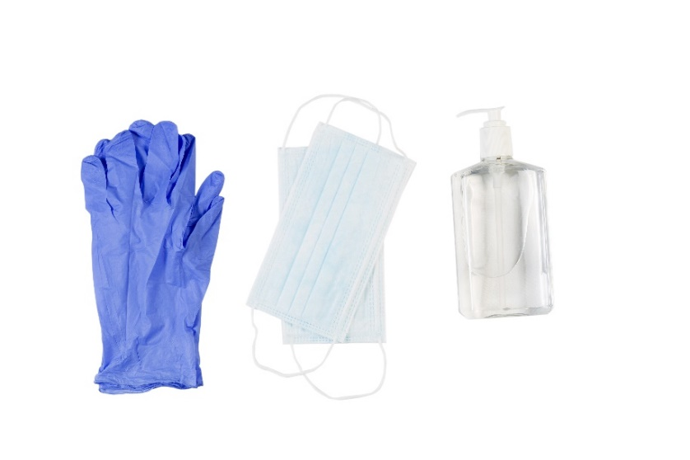
State Agency PPE Mission Plan
Items procured for distribution:
  Cleaning wipes/materials
  Clear goggles
  Reusable face masks
  Disposable gloves
  Hand sanitizer
  Hand soap
  Paper towels
  Plastic Shields
  Plexiglass Barriers
Notes:
Items procured for distribution to agencies:
Cleaning wipes/materials
Clear goggles
Cloth face masks
Disposable gloves
Hand sanitizer
Hand soap
Paper towels
Plastic Shields
Plexiglass Barriers

Slide 5

Supply concept
Centralized identification of needs through Admin for all state agencies.
  Admin created a convenient web form.
  Agency HR directors completed the form.
  Agencies entered PPP requests for the three phases of employee re-entry.
Notes:
The supply concept consisted of centralized identification of needs through Admin for all state agencies.
Admin created a web form for agencies to enter estimated quantities of needed items based on the phased re-entry plan for state employees. The form can be found at https://admin.sc.gov/sites/default/files/Re-entry%20plan%20for%20State%20Employees.pdf.
The webform was provided to agency HR Directors for completion, as they have knowledge of the number of employees re-entering the workplace at each phase.
Agencies were asked to submit their PPE requests for all three phases by May 21, 2020, for planning purposes, with the understanding that they would have the opportunity to update estimates for Phases II and III at a later time.

Slide 6
Supply concept
PPE procurement achieved through:
  Admin providing SFAA’s State Procurement Office (MMO) and SCEMD with a list of items to procure and estimated quantities needed.
  SCEMD conducting centralized PPE ordering through MMO.
    This is ongoing based on the list of needs provided by Admin.
Notes:
The supply concept for procurement consisted of:
Admin provided SFAA’s State Procurement Office (MMO) and SCEMD with a list of items to procure and estimated quantities needed.
Centralized PPE ordering by SCEMD through MMO is ongoing based on the list of needs provided by Admin.

Slide 7
Supply Concept
Warehousing Operations include:
  SCDOT’s Shop Road warehouse for centralized receiving and distribution.
    SCEMD is:
      Operating the warehouse with contract labor and supplemental staff from SCDOT.
      Maintaining inventory.
      Packaging and distributing PPE to state agencies.
SCEMD and Admin warehouses for receiving
as needed.
Notes:
Warehousing Operations include:
SCDOT’s Shop Road warehouse for centralized receiving and distribution.
SCEMD is:
Operating the warehouse with contract labor and supplemental staff from SCDOT.
Maintaining inventory.
Packaging and distributing PPE to state agencies.
SCEMD and Admin warehouses for receiving as needed.

Slide 8
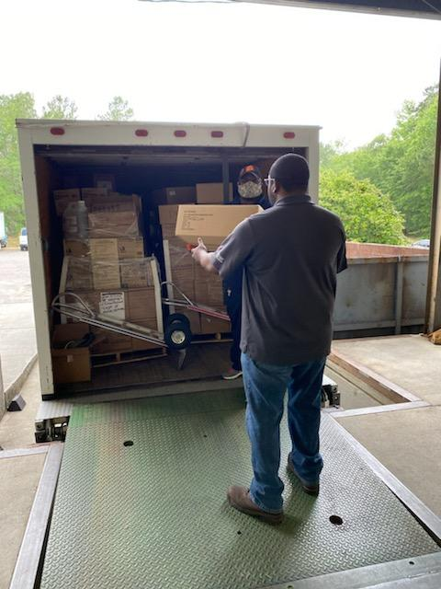
Phase I PPE Distribution – May 27-June 12, 2020
Distributed items:
  3,400 bottles of gallon size hand sanitizer from SCDOT
  6,200 bottles of hand soap
  12,400 rolls of paper towels
  14,000 containers of sanitizing wipes
  19,000 bottles of individual hand sanitizer
  67,000 reusable face masks
  172,000 pairs of disposable gloves
Requests for face shields, clear goggles, sneeze guards
and plexiglass barriers are also filled on an individual basis.
Notes:
Distribution of Phase I PPE to state agencies began on May 27 and will be complete on June 12, 2020.
Distributed items:
3,400 bottles of gallon size hand sanitizer from SCDOT
6,200 bottles of hand soap
12,400 rolls of paper towels
14,000 containers of sanitizing wipes
19,000 bottles of individual hand sanitizer
67,000 reusable face masks
172,000 pairs of disposable gloves
Requests for face shields, clear goggles, sneeze guards and plexiglass barriers are also being filled on an individual basis.

Slide 9
Phases II and III PPE Distribution
Preliminary requests indicate a need for an additional:
  8,500 bottles of gallon sized hand sanitizer
  14,000 rolls of paper towels
  17,000 bottles of hand soap
  46,000 containers of sanitizing wipes
  54,000 bottles of individual hand sanitizer
  93,000 face masks
  350,000 pairs of gloves
Phase II and III distributions will take place the week
prior to each phase’s implementation.
Notes:
Preliminary estimates indicate a need for an additional:
8,500 bottles of gallon sized hand sanitizer
14,000 rolls of paper towels
17,000 bottles of hand soap
46,000 containers of sanitizing wipes
54,000 bottles of individual hand sanitizer
93,000 face masks
350,000 pairs of gloves
Based on these estimates, there is sufficient supply through current orders placed by MMO and either received or scheduled; however, state agencies are currently updating their Phase II and III requests with submissions due by June 11, 2020, which may result in the need for additional procurements.
Phase II and III distributions will take place the week prior to each phase’s implementation.

Slide 10

Funding
PPE costs for state agency needs are initially being funded through the SCEMD.
If CARES Act funding is allocated, SCEMD could be reimbursed.
If not, SCEMD will request FEMA reimbursement, and if FEMA is reimbursed at less than 100%, individual agencies will be responsible for their portion of remaining costs.
Notes:
PPE costs for state agency needs are initially being funded through the SCEMD.
If CARES Act funding is allocated, SCEMD could be reimbursed.
If not, SCEMD will request FEMA reimbursement, and if FEMA is reimbursed at less than 100%, individual agencies will be responsible for their portion of remaining costs.

Slide 11
Questions?

